Slide 1
Problems While Developing & Managing Project
Collaboration
Storing Version
Backup
Analysis
What is the Solution?

Slide 2
Version Control System

Slide 3
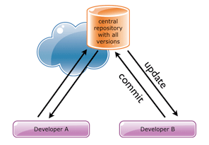
Version Control System Architecture

Slide 4
Advantages of Version Controlling System
It improves collaboration by storing the name of the developer who made the changes & reason for the change
It stores every modification made into the software with different version number which helps in fetching the data from the version which is required
After we perform modifications in the existing code we save it in server which helps in backing up the data. Even if the local system fails we can take the backup from server
Version control system helps in analyse the project progress by defining the changes incorporated in the project like when, what, why & how much time is consumed to incorporate the changes.

Slide 5
Drawback of Version Control System
If the Central repository is crashed then the data saved in the central repository will also be get lost
Whenever we perform any operations on the system & wants to save those changes in the repository then we need to have internet connectivity as it is located in remote server.
While fetching or storing the data on centralized server the speed is low as it needs network connections.
What is the Solution?

Slide 6
Distributed Version Control System

Slide 7
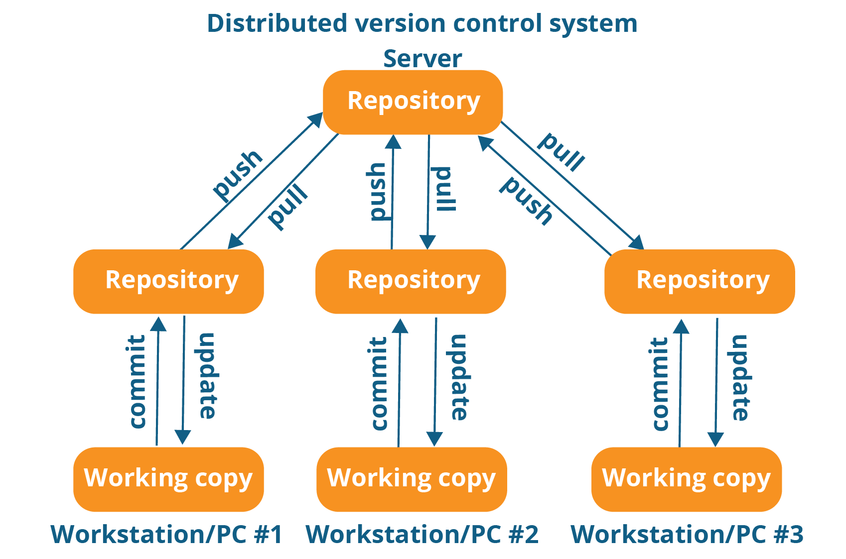
Architecture Of Distributed Version Control System

Slide 8
Advantages of Distributed Version Controlling System
It stores the data in both Local & Remote Repository which helps in recovering data in any of the repository fails or crashes
We can save the files in local repository & when we get network connectivity we can push it to remote repository
As we save the data in local repository hence fetching or storing will be faster

Slide 9
Git
Git is a distributed version control system designed to ensure speed, integrity and support for non-linear workflows.
It is used in both open source and commercial software development environments.
Git is one of the most popular methods in the world for tracking changes.
A key feature is that it enables developers to have independent branches, which turn enables, frictionless context switching, role-based codelines, feature-based workflows and disposable experimentation
Notes:
Having usurped previous version control systems such as CVS and Subversion, Git is now one of the most popular methods in the world for tracking changes.
A key feature is that it enables developers to have independent branches, which turn enables, frictionless context switching, role-based codelines, feature-based workflows and disposable experimentation. Ultimately, this enables more creativity, freedom and possibilities for developers when undertaking complex and challenging work.

Slide 10
Git

Slide 11
What is Git?
Git is an Open Source Distributed Version Control System
It is most Popular tool primary used for source code management in the software development
It can also be used to keep track of changes in any set of files
Git is created by Linus Torvald

Slide 12
Git Features
Branching and Merging
Small and Fast
Distributed
Data Assurance
Staging Area
Free and Open Source
Trademark

Slide 13
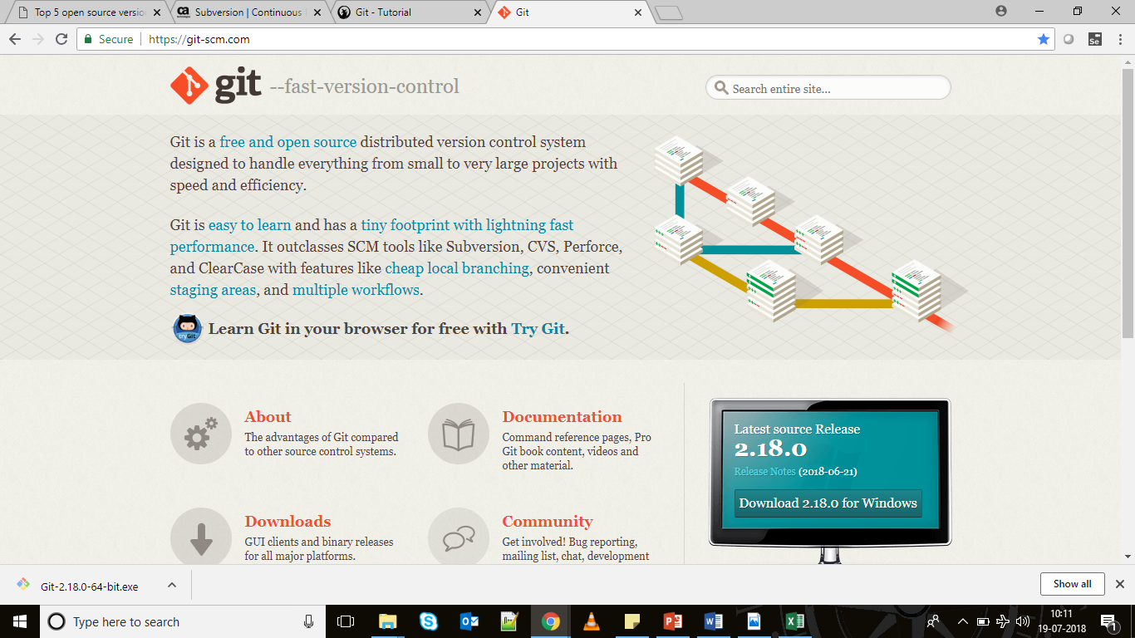
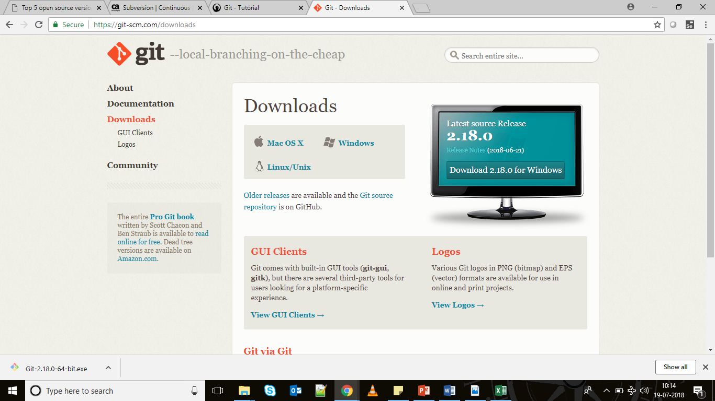
Git Installation
Step 1: Open the Git website & click Step 2: Click on appropriate link Downloads link based on the system OS
Git .exe file will be get downloaded in the local system

Slide 14
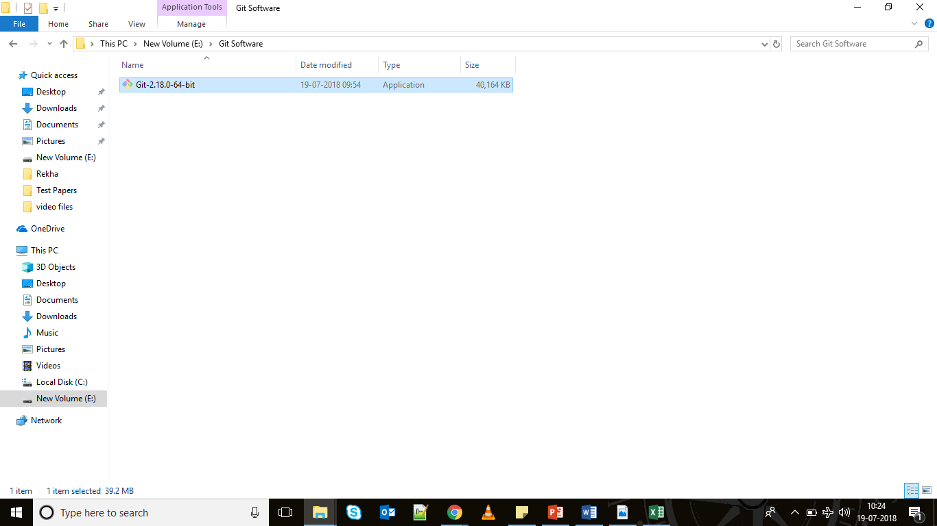
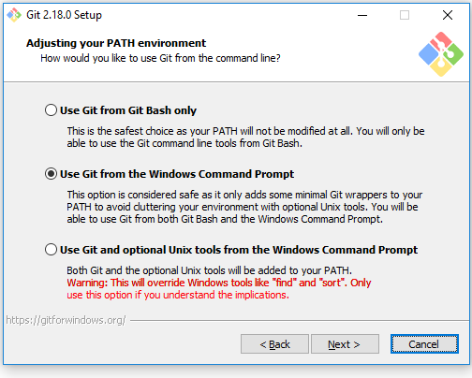
Git Installation
Step 3: Run the .exe file for installation Step 4: Follow the simple step & select the appropriate option

Slide 15
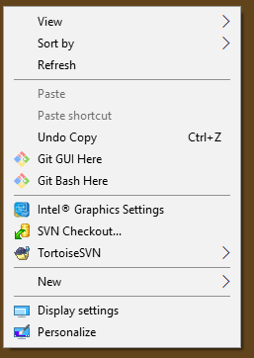
Git Installation
After installation you can see Git option upon right clicking
It confirms the successful Git installation in the system

Slide 16
Git Repository Creation
Commands:
git –version : used to know the installed git version
mkdir Git_Repository : to create a directory named Git_Repository
git init Git_Repository : to create make Git_Repository as a repository
Note: git init creates local repository in the system which contains hidden .git folder

Slide 17
What is a Git Repository?
A Git repository is a virtual storage of your project. It allows you to save versions of your code, which you can access when needed.

Slide 18
Types of Repository
Local Repository: repository which is created in local system
Remote Repository: repository which is present on remote location which is created with the help of github or gitlab etc.

Slide 19
Git Architecture
Working Directory
Git add
Staging Area
reset
Git Repository
commit

Slide 20
Git Commands
git add <filename> : used to add the file into a staging area
git status : to know the status of the files
git commit : to add file into repository
i : to insert the comment
esc key: to come out of the comment line
:wq : to save the comment message

Slide 21
Git Commands
git add . : to add all files present in the directory to staging area
git add *.txt : to add all files which are ending with txt present in the directory to staging area
git log : to know the complete status of the repository
Git reset : to remove the file from staging area to directory back
Note: reset can happen before commit only

Slide 22
git diff
git rm <filename> to remove the file from directory
Git mv <file_from> <file_to> to rename a file

Slide 23
History
To know the complete history of committed files in git use below command
Git log
To restrict to number of entries
Git log –p -2
To know statistics of committed files
Git log –stat
To display in one line
Git log –pretty=oneline
Note: you can use short, full & fuller

Slide 24
Branching commands
Creating branch
git branch Manzoor
Working on created branch
git checkout Manzoor
Note: to switch between the branches use git checkout <branchname> which you want to switch

Slide 25
Merging Branches
Know the destination branch where you want to merge the branch
Point your git to the destination branch & perform below command
Commands
git merge <branchname>
Note: while merging the branches if there is any difference between the files of merging branches then it will be get display as “fix conflicts and run git commit” message & difference in the file which has conflicts

Slide 26
Github
GitHub is a code hosting platform for version control and collaboration. It lets you and others work together on projects from anywhere
GitHub Flow is a lightweight, branch-based workflow that supports teams and projects where deployments are made regularly

Slide 27
Cloning Remote Repository
Command:
git clone <Remote_Repository_URL>
To know which remote repository you cloned
git remote
To create repository in remote
Git remote add <nameOfREpository> <URL_ofRemote>

Slide 28
Fetching and Pulling
Git fetch <remote>
Above command will fetch the remote file into local without merging the files
Git pull <remote>
Above command will fetch the remote file into local by merging the files

Slide 29
Adding an repository into git
Add the repository in git to perform operations on remote repository
Git remote add name <url of the repository>
Note: name created can be used to perform any operations on the remote repository

Slide 30
Pushing to Remote
Git push <remote> <branch>
Ex: git push origin master
Git remote show origin
To rename the repository
Git remote rename <from> <to>
To remove the repository
Git remote remove <name>
Notes:
Note: while pushing files into repository if anyone has pulled before to you then you cant push directly into the same branch. What you need to do is pull the changes into your local repository & then incorporate those changes into it & then push it

Slide 31
Fork Repository
To access the repository of some other person in github we use fork
Search for a particular person → open the repository you want to copy → click on fork button
Selected repository will be copied into your github account

